Slide 1



SMART PARKING SYSTEM USING VERILOG HDL

Slide 2
Project Overview
Project Objective:
To design and implement a fully autonomous, and accurate smart parking controller that can independently manage vehicle entry, parking slot assignment, time tracking, billing, and exit operations using a synchronized digital logic system with Verilog HDL.
01
The project delivers a fully autonomous parking controller that simulates a real-world multi-slot parking facility. The system handles entry detection, parking confirmation, automated slot assignment, billing based on elapsed time, and exit authorization only after payment is confirmed—ensuring secure, orderly, and accurate vehicle processing.
03
Technical Architecture
A centralized FSM governs system flow—from entry detection to slot assignment, billing activation, waiting for payment, and final exit authorization. The design integrates multiple interacting hardware modules including a Slot Manager, Timer & Billing Unit, Payment Logic, and Gate Actuation. Each module operates synchronously under clock control, enabling reliable and predictable state transitions.
02
System Capabilities
The system supports up to four parking slots and performs deterministic first-fit allocation. It continuously monitors slot availability, prevents entry when the lot is full, and enforces proper exit flow by requiring payment before barrier activation. The design also features automated gate control, real-time timer-based billing, fallback behavior on user selection errors, and full operational feedback via visible system signals.
04
Verification & Validation
The system is validated using structured module-level and top-level simulation testbenches. Extensive waveform analysis confirms correct state sequencing, accurate billing computation, proper slot tracking, enforcement of payment-before-exit logic, and robust handling of edge cases such as full capacity, invalid exit selection, payment not completed, timer restart after reentry.

Slide 3
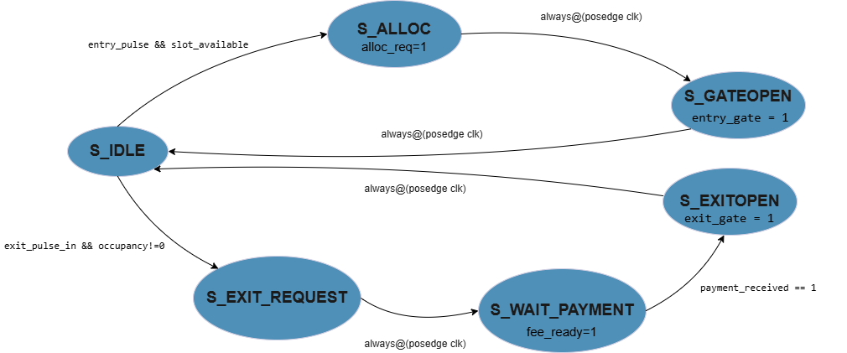
Core Logic: FSM Controller Architecture

Slide 4
Module: FSM controller
Key Responsibilities
  When a car arrives, it tells the slot manager to allocate a slot.
  Then it opens the entry gate.
  When a car wants to exit, it asks the billing module to calculate the fee.
  It waits until payment is received.
  After payment, it tells the slot manager to free the slot.
  Then it opens the exit gate.
PSEUDOCODE:
STATE MACHINE:
Initial State → IDLE
LOOP forever:
IDLE:
If entry_pulse AND slot_available:
Go to ALLOCATE_SLOT
Else if exit_pulse AND at least one car inside:
Go to EXIT_REQUEST
ALLOCATE_SLOT:
Signal alloc_req = 1
Go to ENTRY_GATE_OPEN
ENTRY_GATE_OPEN:
Open entry gate
Return to IDLE
EXIT_REQUEST:
Signal fee_ready = 1
Go to WAIT_PAYMENT
WAIT_PAYMENT:
fee_ready = 1
If payment_received:
Signal free_req = 1
Go to EXIT_GATE_OPEN
EXIT_GATE_OPEN:
Open exit gate
Go to IDLE
END LOOP

Slide 5
Module: spot manager
The Spot Manager module maintains and updates the status of 4 parking spots.
It handles allocation and freeing of spots, and keeps track of occupancy in real time.
PSEUDOCODE:
ON RESET:
occupancy = 0000 (all empty)
free_count = 4
slot_available = TRUE
LOOP every clock:
IF free_req:
If selected exit slot is occupied:
Clear that slot
Else:
Find the first occupied slot
Clear it
free_count++
IF alloc_req AND free_count > 0:
Find first empty slot
Mark it occupied
allocated_slot = that slot
free_count--
Update slot_available = (free_count > 0)
END LOOP
Key Responsibilities
  Tracks real-time slot occupancy (empty/occupied status).
  Allocates the first available parking slot during entry.
  Frees the correct slot during exit (with fallback if wrong slot selected).
  Updates free slot count and availability signal.
  Communicates allocated and released slot IDs to billing and control modules.

Slide 6
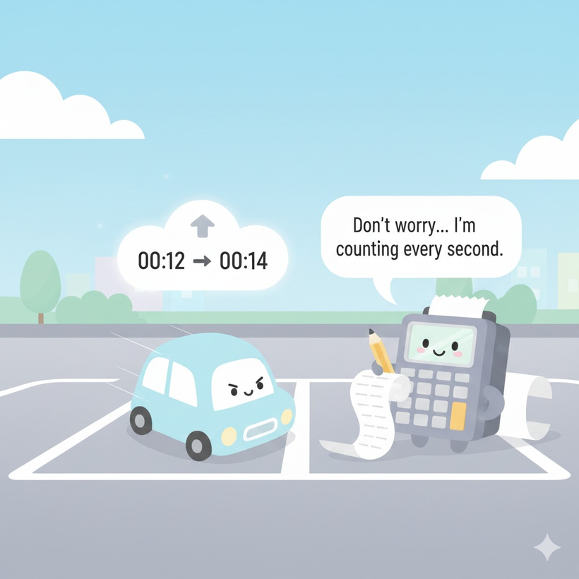
Module: timer & billing module
This module counts parking time for each slot and calculates the final cost when a vehicle exits. It ensures precise and automated billing based on parking duration.
Key Responsibilities
  Tracks parking duration independently for each occupied slot.
  Starts and stops timers based on slot occupancy status.
  Calculates final parking fee when an exit request is confirmed.
  Outputs correct billing amount to the FSM for payment processing.
  Resets the timer for a slot once the vehicle exits.
PSEUDOCODE:
ON RESET:
timers for all 4 slots = 0
running_flags = 0
fee = 0
EVERY CLOCK:
// CALCULATE BILL WHEN EXIT PULSE COMES
If exit_pulse:
fee = elapsed_time(exit_slot) * RATE
// START TIMERS WHEN A CAR ENTERS A SLOT
For each slot i in {0,1,2,3}:
If occupancy[i] == 1:
If timer was OFF:
reset timer[i] to 0
turn timer ON
Else:
turn timer OFF
// INCREMENT TIMERS FOR OCCUPIED SLOTS
For each slot where timer is ON:
timer[i] = timer[i] + 1
END LOOP

Slide 7
Implementation & Testing
After coding and synthesizing the parking system using Verilog HDL, the design was simulated using waveform-based verification. Multiple real-world scenarios were tested to ensure correctness, stability, and edge-case handling.
Testing followed a structured simulation-driven approach using waveform analysis. Both module-level and system-level testbenches were executed to validate functionality under real-world and edge-case scenarios.
✔ Test Coverage Included:
  Test Case 1 : Multiple Cars Enter and Exit in Sequence
  Test Case 2: Exit Denied Until Payment Received
  Test Case 3: Full Lot Condition — Car Attempts Entry
  Test Case 4: Exit Request on an Empty Slot (Fallback Exit Logic)
  Test Case 5: Timer Reset on Re-Entry
▶ Click to Simulate:
https://edaplayground.com/x/c54K
🧪 Test Case 1: Multiple Cars Enter and Exit in Sequence
Objective:
To verify correct slot allocation, timing, billing, and status tracking through multiple complete cycles.
Expected Behavior:
Each parking cycle should run independently with correct timer reset, fee calculation, and occupancy tracking.
Outcome:
✔ System remained stable across repeated operations with no slot conflict, race condition, or billing errors.

Slide 8
▶ Click to Simulate:
https://edaplayground.com/x/F55M
🧪 Test Case 2: Exit Denied Until Payment Received
Objective:
To ensure payment enforcement logic prevents unauthorized exit.
Expected Behavior:
The system should calculate the fee and remain in a waiting state until payment_received = 1, only then allowing the exit.
Outcome:
✔ Exit gate activation occurred only after payment confirmation, validating secure exit control.
▶ Click to Simulate:
https://edaplayground.com/x/SxCr
🧪 Test Case 3: Full Lot Condition — Car Attempts Entry
Objective:
To confirm that no new vehicle can enter when all slots are occupied.
Expected Behavior:
The entry gate should remain closed, and slot allocation should not proceed when free_count = 0.
Outcome:
✔ Entry was blocked correctly and the full_led indicator remained active.

Slide 9
🧪 Test Case 4: Exit Request on an Empty Slot (Fallback Exit Logic)
Objective:
To test system resilience when the user attempts to exit a slot that is not occupied.
Expected Behavior:
The system should ignore the invalid selection and automatically free the lowest-indexed occupied slot.
Outcome:
✔ Fallback mechanism worked as intended and fee was calculated for the correct slot.
▶ Click to Simulate:
https://edaplayground.com/x/TNWp
▶ Click to Simulate:
https://edaplayground.com/x/dMvx
🧪 Test Case 5: Timer Reset on Re-Entry
Objective:
To verify that the timing module resets when a car exits and then re-enters the system.
Expected Behavior:
The timer should stop at exit, compute the correct fee, reset to zero, and restart when the vehicle re-enters.
Outcome:
✔ Timer restarted successfully without retaining previous values, confirming accurate time tracking per parking session.

Slide 10
Conclusion
  The Smart Parking System successfully automates slot allocation, entry control, timing-based billing, and exit authorization using a Verilog-based digital design.
  A centralized FSM ensured reliable synchronization between modules such as slot management, timing, billing, and payment validation.
  Simulation results confirmed correct behavior under realistic scenarios including re-entry, full capacity, incorrect exit selection, and multiple vehicle cycles.
  The modular architecture supports scalability, reusability, and future integration with FPGA hardware or IoT-based enhancements.
  Overall, the project demonstrates an effective digital solution for automated parking control with safe, predictable, and error-tolerant operation.
Limitations & Future Scope
Limitations
  Currently limited to four parking slots.
  Handles events sequentially—no true simultaneous entry/exit support.
  Simulation-only implementation without physical hardware integration.
  Uses a fixed billing rate with no dynamic pricing or membership logic.
Future Scope
  Scale to configurable or higher parking capacity.
  Integrate real hardware (IR sensors, RFID, ANPR, gate motors).
  Add IoT features such as mobile payment, cloud monitoring, and remote access.
  Support advanced pricing models and reservation-based systems.
  Implement parallel event handling with arbitration logic for simultaneous requests.
  Deploy on FPGA/microcontroller for real-world validation.

Slide 11
THANK YOU!

